Slide 1
Algorithm Analysis and Design Divide and Conquer strategy (Maximum Sum Sub-array Problem)
Lecture -15

Slide 2
Overview
• Learn the technique of “divide and conquer”
in the context of the maximum sub-array with
analysis.

Slide 3
The Maximum Sum subarray Problem (A Divide and Conquer Approach)
Divide the problem into a number of sub problems.
Conquer the sub problems by solving them recursively.
Base case: If the sub problems are small enough, just solve them by brute force.
Combine the sub problem solutions to give a solution to the original problem.

Slide 4
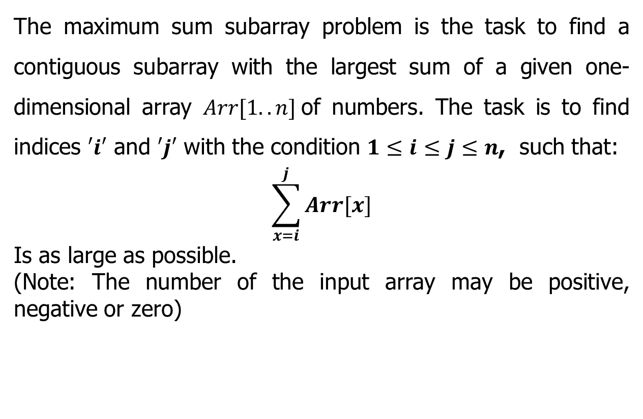
The Maximum sum subarray problem
The maximum sum subarray problem is the task to find a contiguous subarray with the largest sum of a given one-dimensional array $Arr[1..n]$of numbers. The task is to find indices $′i′$ and $′j′$ with the condition $1≤i≤j≤n$, such that:
$$\sum_{x=i}^{j}{Arr[x]}$$
Is as large as possible.
(Note: The number of the input array may be positive, negative or zero)

Slide 5
The Maximum sum subarray problem
Input: an array A[1..n] of n numbers
Assume that some of the numbers are negative, because this problem is trivial when all numbers are nonnegative
Output: a nonempty subarray A[i..j] having the largest sum
S[i, j] = A_{i} + A_{i+1} +... + A_{j}
1 2 3 4 5 6 7 8 9 10 11 12 13 14 15 16
A
13 | -3 | -25 | 20 | -3 | -16 | -23 | 18 | 20 | -7 | 12 | -5 | -22 | 15 | -4 | 7
maximum subarray

Slide 6
The Maximum sum subarray problem
Divide and Conquer Approach
Subproblem: Find a maximum subarray of A[low .. high]
In initial call, low =1 and high= n.
Divide: the subarray into two subarrays of as equal size as possible. Find the midpoint mid of the subarrays, and consider the subarrays A[low ..mid] and A[mid+1 .. high] .
Conquer: by finding the maximum subarrays of A[low .. mid] and A[mid+1..high] .
Combine: by finding a maximum subarray that crosses the midpoint, and using the best solution out of the three (the subarray crossing the midpoint and the two solutions found in the conquer step).

Slide 7
The Maximum subarray problem
Divide and Conquer Approach
crosses the midpoint
low mid high
mid +1
entirely in A[low..mid]
entirely in A[mid+1..high]
Fig (a): Possible locations of subarrays of A[low..high]
A[mid+1..j]
i
low mid high
mid +1
j
A[i..mid]
Fig (b): A[i..j] comprises two subarrays A[i..mid] and A[mid+1..j]

Slide 8
The Maximum subarray problem
Initial call: FIND-MAXIMUM-SUBARRAY(A,1,n)
Divide by computing mid.
Conquer by the two recursive calls to FIND-MAXIMUM-SUBARRAY.
Combine by calling FIND-MAX-CROSSING-SUBARRAY and then determining
which of the three results gives the maximum sum.
Base case is when the subarray has only 1 element.

Slide 9
The Maximum subarray problem

Slide 10
The Maximum subarray problem

Slide 11
The Maximum subarray problem
Divide and Conquer Approach
13 | -3 | -25 | 20 | -3 | -16 | -23 | 18 | 20 | -7 | 12 | -5 | -22 | 15 | -4 | 7
1 | 2 | 3 | 4 | 5 | 6 | 7 | 8 | 9 | 10 | 11 | 12 | 13 | 14 | 15 | 16
Divide
13 | -3 | -25 | 20 | -3 | -16 | -23 | 18 | 20 | -7 | 12 | -5 | -22 | 15 | -4 | 7
1 | 2 | 3 | 4 | 5 | 6 | 7 | 8 | 9 | 10 | 11 | 12 | 13 | 14 | 15 | 16
Divide
13 | -3 | -25 | 20 | -3 | -16 | -23 | 18 | 20 | -7 | 12 | -5 | -22 | 15 | -4 | 7
1 | 2 | 3 | 4 | 5 | 6 | 7 | 8 | 9 | 10 | 11 | 12 | 13 | 14 | 15 | 16
Divide
13 | -3 | -25 | 20 | -3 | -16 | -23 | 18 | 20 | -7 | 12 | -5 | -22 | 15 | -4 | 7
1 | 2 | 3 | 4 | 5 | 6 | 7 | 8 | 9 | 10 | 11 | 12 | 13 | 14 | 15 | 16
Divide
13 | -3 | -25 | 20 | -3 | -16 | -23 | 18 | 20 | -7 | 12 | -5 | -22 | 15 | -4 | 7
1 | 2 | 3 | 4 | 5 | 6 | 7 | 8 | 9 | 10 | 11 | 12 | 13 | 14 | 15 | 16

Slide 12
The Maximum subarray problem
Divide and Conquer Approach
maximum subarray
13 | -3 | -25 | 20 | -3 | -16 | -23 | 18 | 20 | -7 | 12 | -5 | -22 | 15 | -4 | 7
1 | 2 | 3 | 4 | 5 | 6 | 7 | 8 | 9 | 10 | 11 | 12 | 13 | 14 | 15 | 16
LS=20
RS=25
Conquer
CS=43
13 | -3 | -25 | 20 | -3 | -16 | -23 | 18 | 20 | -7 | 12 | -5 | -22 | 15 | -4 | 7
1 | 2 | 3 | 4 | 5 | 6 | 7 | 8 | 9 | 10 | 11 | 12 | 13 | 14 | 15 | 16
LS=20
RS=18
LS=25
RS=18
Conquer
CS=17
CS=16
13 | -3 | -25 | 20 | -3 | -16 | -23 | 18 | 20 | -7 | 12 | -5 | -22 | 15 | -4 | 7
1 | 2 | 3 | 4 | 5 | 6 | 7 | 8 | 9 | 10 | 11 | 12 | 13 | 14 | 15 | 16
LS=13
RS=20
LS=-3
RS=18
LS=20
RS=12
LS=15
RS=7
Conquer
CS=5
CS=-21
CS=25
CS=18
13 | -3 | -25 | 20 | -3 | -16 | -23 | 18 | 20 | -7 | 12 | -5 | -22 | 15 | -4 | 7
1 | 2 | 3 | 4 | 5 | 6 | 7 | 8 | 9 | 10 | 11 | 12 | 13 | 14 | 15 | 16
LS=13
LS=-23
RS=18
LS=20
LS=12
RS=-5
LS=-22
LS=-4
RS=7
LS=-25
RS=-7
RS=15
RS=-3
RS=20
LS=-3
RS=-16
Conquer
CS=10
CS=-5
CS=-19
CS=-5
CS=13
CS=7
CS=-7
CS=3
13 | -3 | -25 | 20 | -3 | -16 | -23 | 18 | 20 | -7 | 12 | -5 | -22 | 15 | -4 | 7
1 | 2 | 3 | 4 | 5 | 6 | 7 | 8 | 9 | 10 | 11 | 12 | 13 | 14 | 15 | 16
[Note: Where LS (Left Sum), RS (Right Sum) and CS (Cross Sum)]

Slide 13
Analysing Maximum subarray problem

Slide 14
Analysing Maximum subarray problem

Slide 15
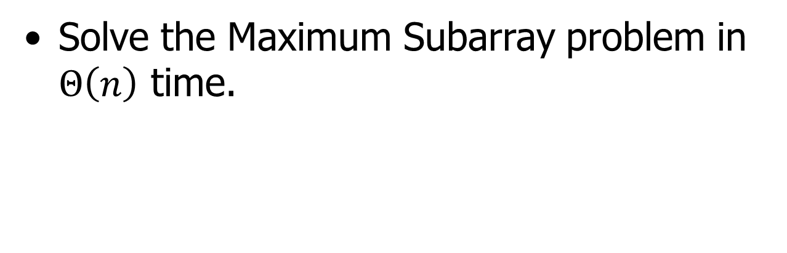
Home Assignment
Solve the Maximum Subarray problem in $Θ\left(n\right)$ time.

Slide 16

Thank U

